Slide 1
Key Behaviors of Nuclear Reaction Networks
Brad Meyer
Clemson University

Slide 2
Supernova Machines
The primary SN machine converts gravitational work into energy that is transported by neutrinos or advection to the SN mantle. That energy causes its explosive ejection.
The secondary SN machine creates excess Coulomb energy within nuclei by gravitational compression of the Si shell resulting in larger Z = N nuclei. That excess energy is released only later after considerable expansion and thinning, and that delayed energy release emits non-thermal energy into the mantle.

Slide 3
56Ni→56Co→56Fe
6 days
77 days

Slide 4
SNII (particularly SN 1987A) displays due to the Secondary Machine
Gamma-ray lines (Matz et al. 1988)
Continuous spectrum of X rays (Sunyaev et al. 1987, Dotani et al. 1987)
Non-thermal species visible or inferred from IR in SN atmospheres: He⁺ (Graham 1988) and free C and O (e.g., Liu & Dalgarno 1995)
The supernova light curve after the first month (e.g., Catchpole et al. 1987)

Slide 5
Energetics
Gravitational binding energy release: ~10⁵³ ergs (WD->NS--neutrino energy release)
Primary machine: ~10⁵¹ ergs (SN shock--dissipated in ISM)
Secondary machine: ~10⁴⁹ ergs (excess Coulomb energy--radiated)

Slide 6
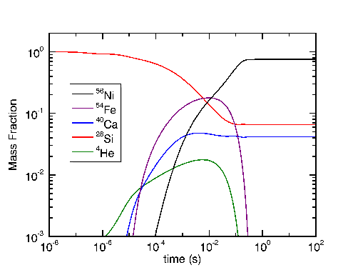
T9,0=5

Slide 7
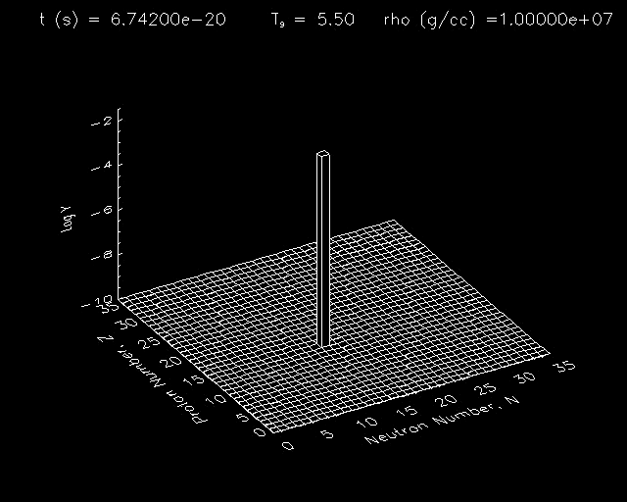

Slide 8
“28Si + 28Si➔56Ni”
Z/A = 1/2

Slide 9
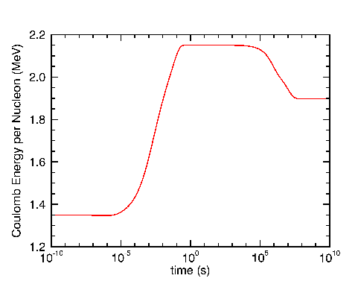
EC ~Z²/A^{1/3}=>EC/A ~ (Z/A)^{4/3} x Z^{2/3}
Mass formula: Myers and Swiatecki (1966)

Slide 10
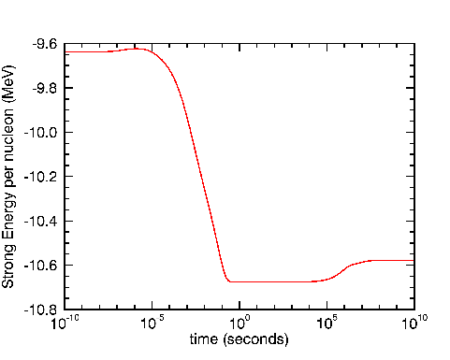
ES ~-aA + bA^{2/3}=>ES/A ~ -a + bA^{-1/3}

Slide 11
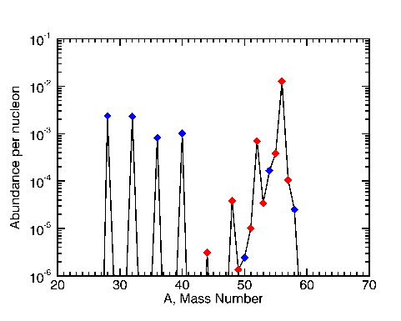
T9,0=5

Slide 12
“Metastable state of Si burning”
↓

Slide 13
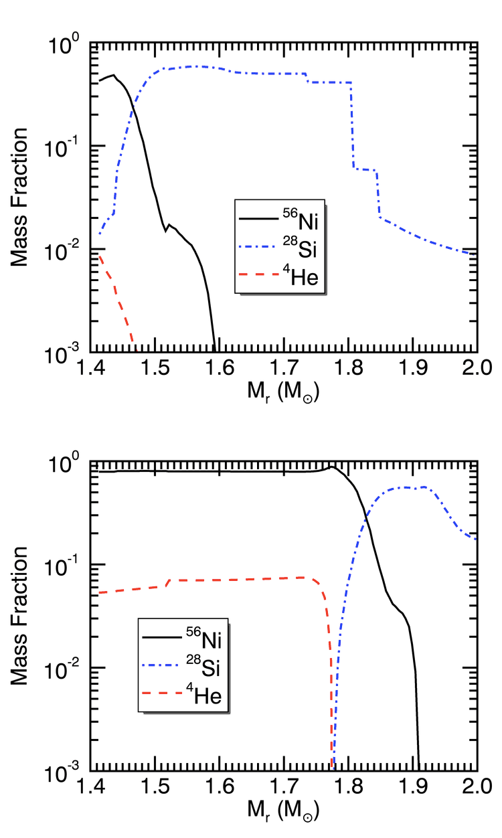

Slide 14
Energetics
excess Coulomb energy = 0.25 - 0.1 - 0.03 = 0.12 MeV/nucleon
0.12 MeV/nucleon x 1.6 x 10⁻⁶ ergs/MeV x 0.06 M⊙ x
2 x 10³³ g/M⊙ x 6 x 10²³ nucleons/g = 1.4 x 10⁴⁹ ergs

Slide 15
The Secondary Machine
gravitationally-induced compression of Si shell➔storage of Coulomb energy in alpha nuclei➔delayed emission of excess Coulomb energy via weak decays➔derivative astronomical displays
http:/nucnet-projects.sf.net/data_pub/2014-04-24

Slide 16
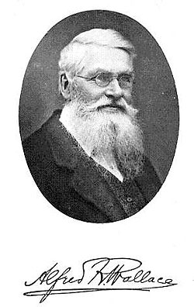

Slide 17
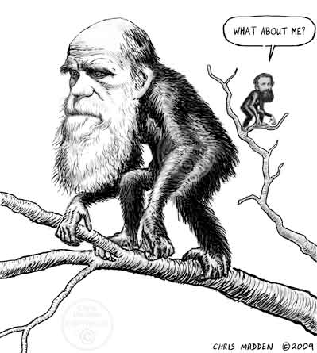

Slide 18
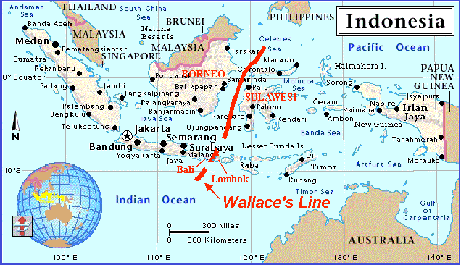

Slide 19
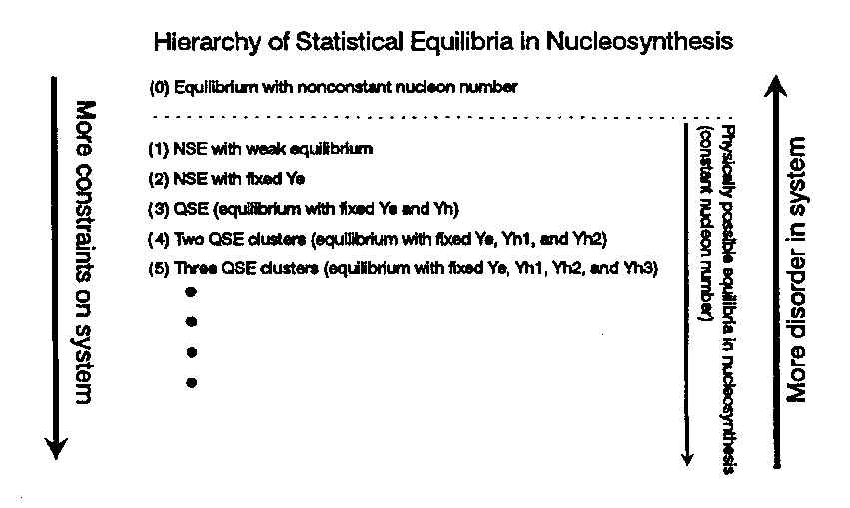

Slide 20
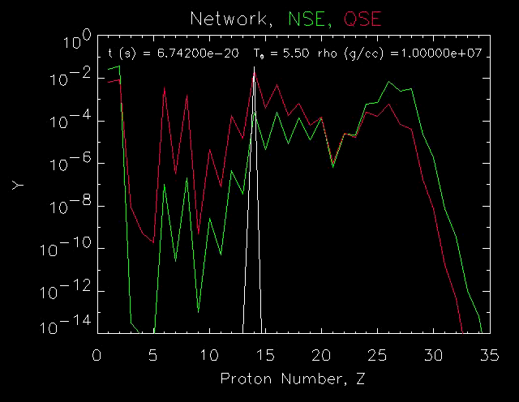

Slide 21
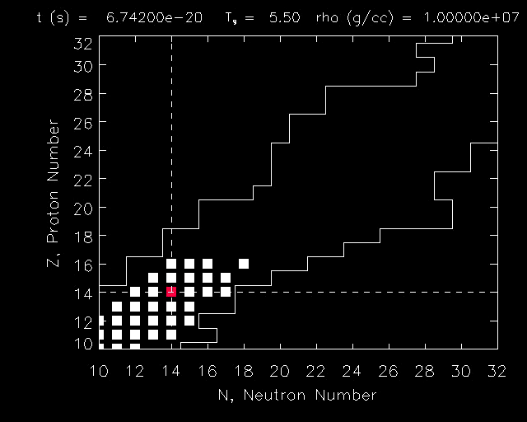

Slide 23
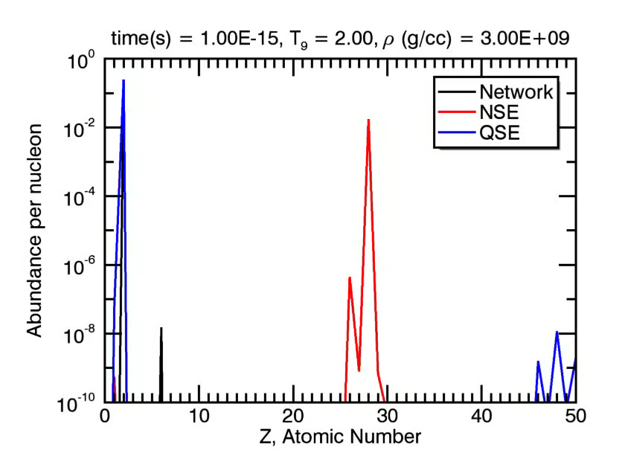

Slide 24
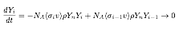
Steady flow

Slide 25
